Slide 1



Introduction to Silverlight
Session 1
Copyright © 2009. Cybage Software Pvt. Ltd. All Rights Reserved. Cybage Confidential.

Slide 2
www.cybage.com
Agenda
Evolution of Web Technology
Rich Internet Application (RIA)
What Is Silverlight?
WPF and Silverlight
Silverlight Architecture
...
Copyright © 2009. Cybage Software Pvt. Ltd. All Rights Reserved. Cybage Confidential.

Slide 3
www.cybage.com
Evolution of Web Technology
Technology
HTML
ASP
ASP.NET (2.0, 3.0, 3.5, 4.0)
AJAX
Silverlight (1.0, 2.0, 3.0,4.0)
...
Copyright © 2009. Cybage Software Pvt. Ltd. All Rights Reserved. Cybage Confidential.

Slide 4
www.cybage.com
Rich Internet Application (RIA)
Rich Internet Applications (RIA) are web applications that have some characteristics of Desktop Applications.
RIA’s work in a Sandbox environment. Sandbox typically provides a tightly-controlled set of resources for guest programs to run in.
RIA’s require developers to include keywords, descriptions, HTML tags and content for search engine optimization.
RIA applications require a plug-in to work.
RIA technologies out there:
Flash, Flex, JavaFX, Silverlight
...
Copyright © 2009. Cybage Software Pvt. Ltd. All Rights Reserved. Cybage Confidential.

Slide 5
www.cybage.com
What Is Silverlight?
Browser plug-in for building RIA’s.
Vector graphics with transform and animation
HD Videos
HTML Integration
.NET Programming Model
.NET based (Write in C# or VB.NET)
JavaScript Support
Multi Platform
Multi Browser
...
Copyright © 2009. Cybage Software Pvt. Ltd. All Rights Reserved. Cybage Confidential.

Slide 6
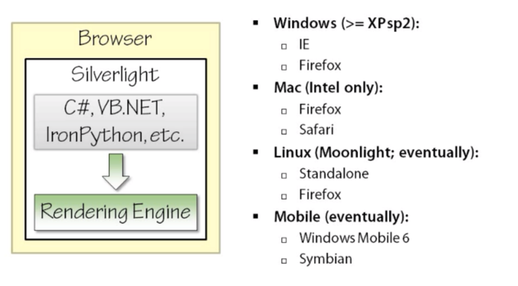
www.cybage.com
What Is Silverlight?
Platforms and Browsers
...
Copyright © 2009. Cybage Software Pvt. Ltd. All Rights Reserved. Cybage Confidential.

Slide 7
www.cybage.com
What Is Silverlight?
Silverlight Evolution
Silverlight 1.0
Graphic, Media and scripts
Only JavaScript based programming model
Silverlight 2.0
Support for .NET (C# & VB)
Multi Threading, Localization, Enhanced Controls etc
Silverlight 3.0
LOB oriented enhancements
Out Of Browser, Better Graphic and Animation, Enhanced Binding
Silverlight 4.0
Printing, Webcam, Microphone etc
...
Copyright © 2009. Cybage Software Pvt. Ltd. All Rights Reserved. Cybage Confidential.

Slide 8
www.cybage.com
Silverlight and WPF
Intended for different scenarios
WPF features not in Silverlight
Hardware Accelerations, Drawing Types, Flow Text
Less powerful feature
Layout, Resources, Templates, Style
Silverlight features not in WPF
Browser Integrations, Video Brush, Deep Zoom
WPF Negatives
Windows only
Requires 50/300MB of .NET 3.5 and 4.0
Silverlight Positives
Available on both Windows and Mac
Lightweight at 4-6 MB
...
Copyright © 2009. Cybage Software Pvt. Ltd. All Rights Reserved. Cybage Confidential.

Slide 9
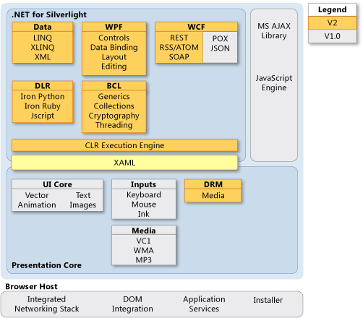
www.cybage.com
Silverlight Architecture
...
Copyright © 2009. Cybage Software Pvt. Ltd. All Rights Reserved. Cybage Confidential.

Slide 10
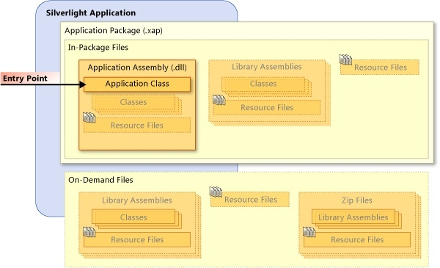
www.cybage.com
Silverlight Packaging
Copyright © 2009. Cybage Software Pvt. Ltd. All Rights Reserved. Cybage Confidential.

Slide 11
www.cybage.com
Getting Started
Silverlight application is packaged into a .xap file. The .xap file is nothing more than a .zip file.
Main Dll
Dependent Dll’s
Resources
Manifest
HTML Page
Plug-in
Optional detection/install UI
Compiled Silverlight Application
XAML
.NET Code
Copyright © 2009. Cybage Software Pvt. Ltd. All Rights Reserved. Cybage Confidential.

Slide 12
www.cybage.com
Summary
Evolution of Web Technology
Rich Internet Application (RIA)
What Is Silverlight?
WPF and Silverlight
Silverlight Architecture
Copyright © 2009. Cybage Software Pvt. Ltd. All Rights Reserved. Cybage Confidential.

Slide 13

www.cybage.com
Thank You!
Copyright © 2009. Cybage Software Pvt. Ltd. All Rights Reserved. Cybage Confidential.

